Slide 1
Passerelles numériques
A Gateway for Life
Relational Model

Slide 2
Objectives
Relational model
Importance of keys
Normalizing
Notes:
Concept of keys

Slide 3
Course Topics
Entity
Relation
Keys
Primary Key
Foreign Key
Data Normalization
1NF
2NF
3NF

Slide 4
Entity
An entity is something important that user or organization need to store its information in a database.
An entity represents one theme or business concept
Ex: employee, department, project,…
Notes:
Entity sty important and we want to store the information about this entity in the Database
Conceptually speaking an entity should represent a single theme or bz concept
For example: employee might be an entity, department might be an entity, project might be an entity. Each of these is a single bz concept about which we might want to track information on several different attributes

Slide 5
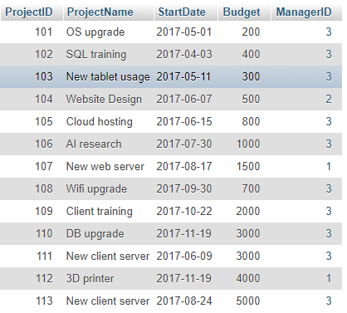
Entity
Project Entity
Notes:
Information about the project (name, date, budget…) and who is the manager of that particular project.
We will talk more in the Entity Relation Model

Slide 6

Relation
A relation is a two dimensional table that has specific characteristics
Attribute of an entity
An instance of the entity
Notes:
A relation is a table.
A table is 2d grid which contain rows and columns
A relation is a specific type of table. In order for a table to qualified as a relation
Table must has certain characteristics. Let’s see what those characteristics are

Slide 7
Characteristics of a Relation
Rows contain data about instances of an entity
Notes:
Each row represents a single project

Slide 8
Characteristics of a Relation
Columns contain data about attributes of the entity
Notes:
Each column is an attribute

Slide 9
Characteristics of a Relation
Cells of the table hold a single value
Notes:
Cell is the intersection btw row and column: no more than one value in the same cell

Slide 10
Characteristics of a Relation
All values in a column have the same data type
Each column has a unique name
The order of the columns and rows doesn’t matter
No two rows are the same or identical

Slide 11
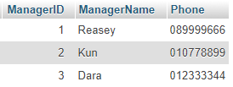
A Relation Example

Slide 12
Terminology
Synonyms
Table | Row | Column
File (rarely) | Record | Field
Relation | Tuple (rarely) | Attribute
Notes:
Perhaps you read books, take another course or talk to other db analyser. You might hear different terminology. But it means same thing

Slide 13
Keys
A key is one (or more) columns of a relation whose values are used to identify a row
Keys could be
Unique key
Uniquely identify a row
Non unique key
Identify a set of rows
Notes:
General idea is the value in the column used to identify a row

Slide 14
Unique vs Non unique Key
Unique Key
Non Unique Key

Slide 15
Keys
Unique key:
Candidate key
Primary key
Composite key
Surrogate key
Non Unique key:
Foreign key

Slide 16
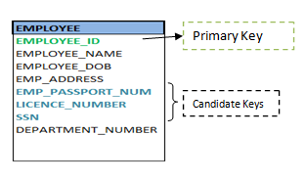
Candidate Key
Potential key to become the primary key
All of the possible unique keys in the entity
Notes:
Like in the state for president election there’re candidates that could potentially be a president
Though a person can be identified using his SSN, passport# or license#, one can choose any one of them as primary key to uniquely identify a person. Rest of them will act as a candidate key.

Slide 17
Primary Key
is the candidate key, which will be used to uniquely identify a record by the query

Slide 18
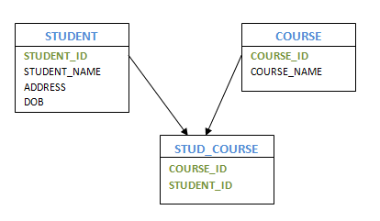
Composite Key
Composed of two or more attributes or column
Example: in many to many relationship the immediate table will contain primary key composed of two columns
Another example: could be the case that we need to combine more than 1 column to make unique key
Notes:
Sometimes we need to make the key unique with combination of more than 2 columns

Slide 19
Surrogate Key
A unique key, numeric value (integer) that is added to a relation to serve as the primary key
Surrogate key values have no meaning to users
Notes:
Artificial Key: primary key is large and complex. Sometime the combination key is complex

Slide 20
Relationships Between Tables
A table may be related to other tables
Ex:
A Manager controls many Projects
An Employee works in a Department
A company accepts many interns
Notes:
Here we will talk about the concept of foreign key
How this relationship could establish or occur between the tables

Slide 21


Foreign Key
To establish relationships, we need a foreign key
A foreign key is a primary key from one table which is added or placed into another table
Primary Key
Foreign Key
Notes:
On purpose of linking the record of those table together
Fk is non unique key

Slide 22
Referential Integrity
Every value of a foreign key must match a value of an existing primary key.
200 | Networking | 2017-12-12 | 4000 | 4
Notes:
Useful cabalitity that we gain from fk and pk relationship is the ability to enforce referential integrity help us to preserve the quality of our data in db.
Say adding new project to project table with the managerid:4 which doesn’t exist in the mager table it will error. Coz it will look in the manager table and check to see weather the managerid 4 exist.
Note that managerid acts as pk in manager table and fk in project table

Slide 23
Null Values
A null value means no data exists
Think it as an empty cell in the table
It’s different from a zero, space, empty string or tab character
Ex: resign date of the employee might set to NULL since they still working and don’t know the when they will stop working
Notes:
Sometimes beneficial sometimes also could cause problem.
Null is often ambiguous: value not appropriate, value not been decided, value is unkown.
Remember the problem in the list about the empty cell (insertion anomaly) so with dbms it will help minimize or entirely eliminate all the empty cell with the process called Normalization.

Slide 24
Data Normalization
A process of analysing a relation to ensure that it is well-formed
Normalization involves decomposing relations with anomalies to produce smaller, well-structured relations
If a relation is normalized (well-formed), rows can be inserted, deleted or modified without creating anomalies

Slide 25
Normalization Principles
Any relation that is not well-formed should be broken into two or more well-formed relations
General rule: a well-formed relation will not contain more than one business concept

Slide 26
Normalization Steps
Frist normal form (1NF)
Second normal form (2NF)
Third normal form (3NF)
Notes:
The goal is to reach 3NF

Slide 27


